Slide 1

Rusterizer Masterclass 05 Rendering Pipeline
Luca Quartesan – quartesan.l@buas.nl – 17/11/2023

Slide 2
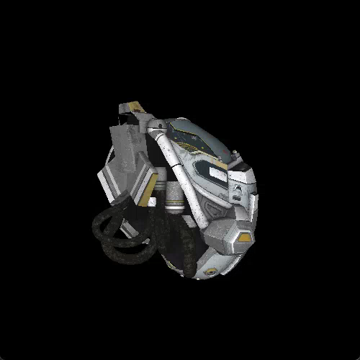
Agenda
Recap
Let’s compare with OpenGL
Powering up your Rusterizer

Slide 3
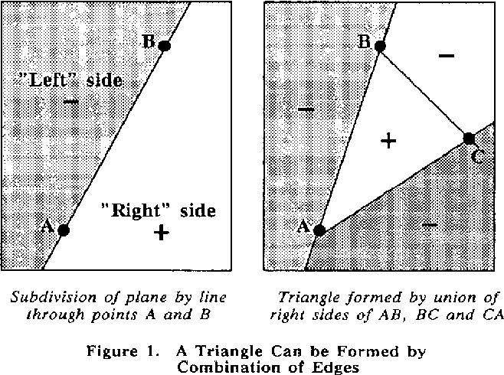
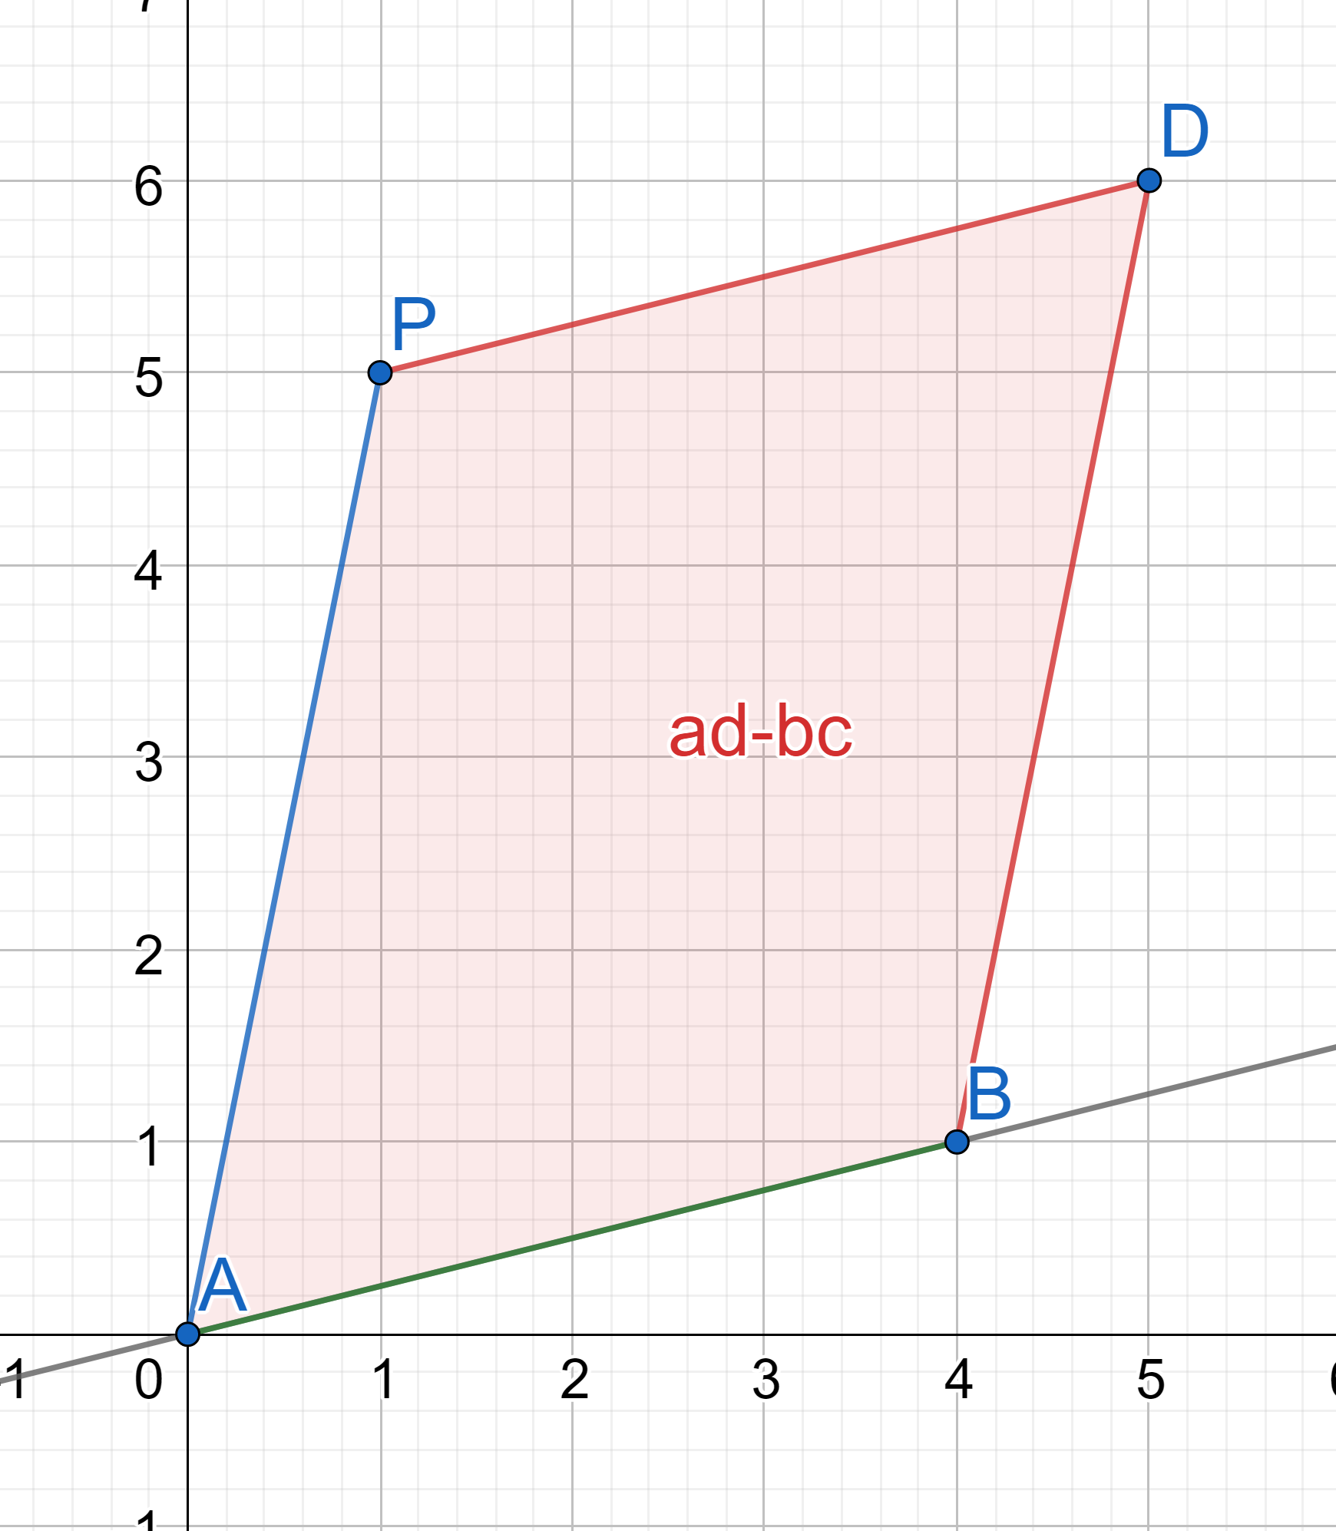
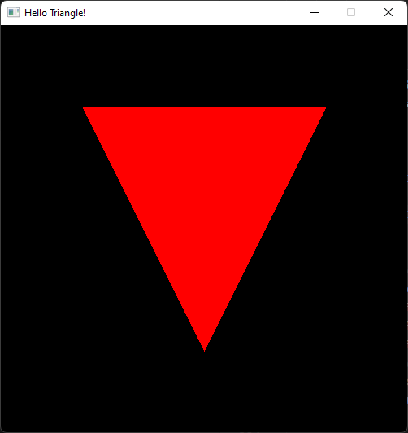
Recap 1
Edge function tells on which side of a line a point lies
Calculated using matrix determinant (cross product), which returns the signed area of the parallelogram
We compute the edge function for each edge
If all positive then the point is inside the triangle
Did you try with counter clockwise triangles?

Slide 4
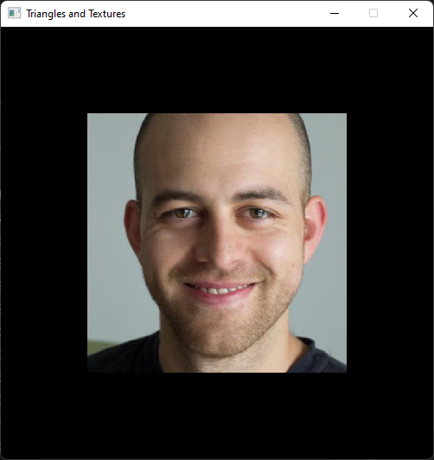
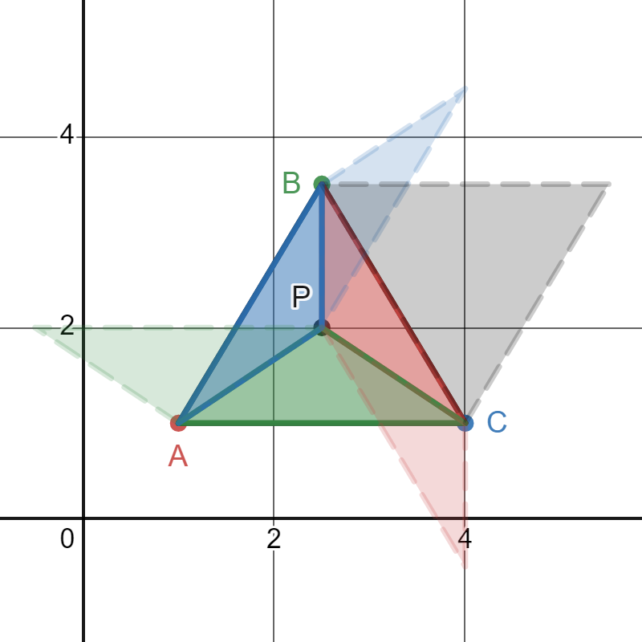
Recap 2
Vertex attributes describe position and other surface parameters
We can map textures to surfaces
When rasterizing a surface we interpolate the vertex attributes
We can do this with barycentric coordinates
Barycentric coordinates ⚖️ weights
how close we are to a vertex
how much a that vertex contributes

Slide 5
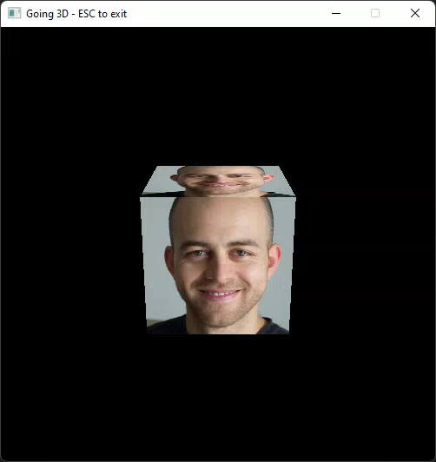
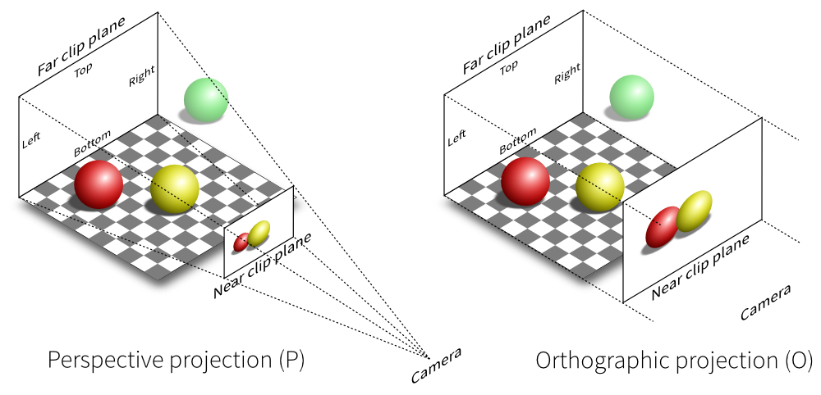
Recap 3
3D Transformations = Matrices * Vectors
Concatenating transformations
Model * View * Projection to transform from 3D to 2D
Perspective correction to interpolate while taking depth into account
https://stackoverflow.com/questions/36573283/from-perspective-picture-to-orthographic-picture

Slide 6
Recap 4
Clipping: ✂️ triangles partially outside the view volume
Culling: 🗑️discarding triangles based on the direction they are facing
Loading a model (GLTF)
Transforming and using Normals
Simple shading: Normal dot light direction + ambient

Slide 7
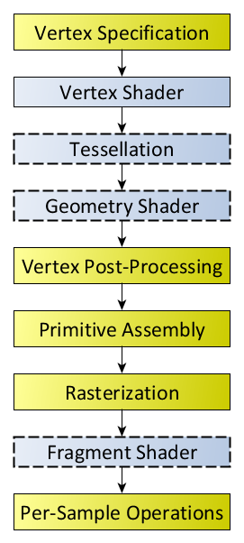
Open GL Rendering pipeline
Yellow boxes are fixed stages
Blue boxes are programmable stages of the pipeline
We can control what happens
https://www.khronos.org/opengl/wiki/Rendering_Pipeline_Overview

Slide 8
Vertex Specification
The application sets up an ordered list of vertices:
Vertex Buffer Object (VBO):
Vertex data/attributes
Vertex Attribute Object (VAO):
References/Indices into VBO
https://www.khronos.org/opengl/wiki/Rendering_Pipeline_Overview

Slide 9
Vertex Processing
Vertex shader:
Vertex in, vertex out
Define operations to apply on incoming vertices
If no tessellation and geometry expected to return the vertex after projection
Vertex * MVP happens here
https://www.khronos.org/opengl/wiki/Rendering_Pipeline_Overview

Slide 10
Vertex Processing
Tessellation:
Primitives (e.g. Triangles) can be further split
Geometry shader
Process incoming primitive returning either zero or more output primitives
https://www.khronos.org/opengl/wiki/Rendering_Pipeline_Overview

Slide 11
Vertex post-processing
Transform Feedback
Primitive assembly
Collect vertex data from previous stages into a sequence of primitives (lines, points, or triangles)
Clipping
Primitives are clipped with view volume
Perspective divide
Divide vertex attributes by the clip space w (view z)
https://www.khronos.org/opengl/wiki/Rendering_Pipeline_Overview

Slide 12
Vertex Post processing
Clipping
We discard and split primitives that don’t lay completely inside the view volume
Face culling
Triangles are discarded based on the direction they are facing
https://www.khronos.org/opengl/wiki/Rendering_Pipeline_Overview

Slide 13
Rasterization
Primitives rasterized in the order they were provided
Results in a sequence of fragments
Fragment: state used to compute the final pixel color. It describes screen space position and interpolated user defined data
https://www.khronos.org/opengl/wiki/Rendering_Pipeline_Overview

Slide 14
Fragment Processing
Fragment Shader
Data for each fragment is processed and a color is returned
Per-sample operations
sequence of culling tests
Pixel ownership
Scissor Test
Stencil Test
Depth Test
https://www.khronos.org/opengl/wiki/Rendering_Pipeline_Overview

Slide 15
Per-Sample Operations
Sequence of culling tests
Pixel ownership
Scissor Test
Stencil Test
Depth Test
Color blending
Blend between color in the framebuffer and fragment output
https://www.khronos.org/opengl/wiki/Rendering_Pipeline_Overview
Notes:
Pixel ownership test: Fails if the fragment's pixel is not "owned" by OpenGL (if another window is overlapping with the GL window). Always passes when using a Framebuffer Object. Failure means that the pixel contains undefined values.
Scissor Test: When enabled, the test fails if the fragment's pixel lies outside of a specified rectangle of the screen.
Stencil Test: When enabled, the test fails if the stencil value provided by the test does not compare as the user specifies against the stencil value from the underlying sample in the stencil buffer. Note that the stencil value in the framebuffer can still be modified even if the stencil test fails (and even if the depth test fails).
Depth Test: When enabled, the test fails if the fragment's depth does not compare as the user specifies against the depth value from the underlying sample in the depth buffer.

Slide 16
Pipeline comparison
We managed to implement a form of most of the stages in the open GL rendering pipeline
Only tessellation and geometry shader were not addressed at all (for good reason)
👏
Now let’s have a look at how you can power up your rasterizer!

Slide 17
Thank you! 🦀
Any questions?

Slide 18
Submission
GO WILD
Create a github repo from this template
https://github.com/Quartenia/ruster-submission-template
Or add it to your portfolio/github page

Slide 19
Resources
Rasterization: a Practical Implementation
Optimizing Software Occlusion Culling – index | The ryg blog
Texture Mapping & Polygon Rasterizing Tutorial (1/2) [C++20] – YouTube
3D Programming Fundamentals [Introduction] Tutorial 0 – YouTube
Rasterizer Algorithm Explanation – YouTube

Slide 20
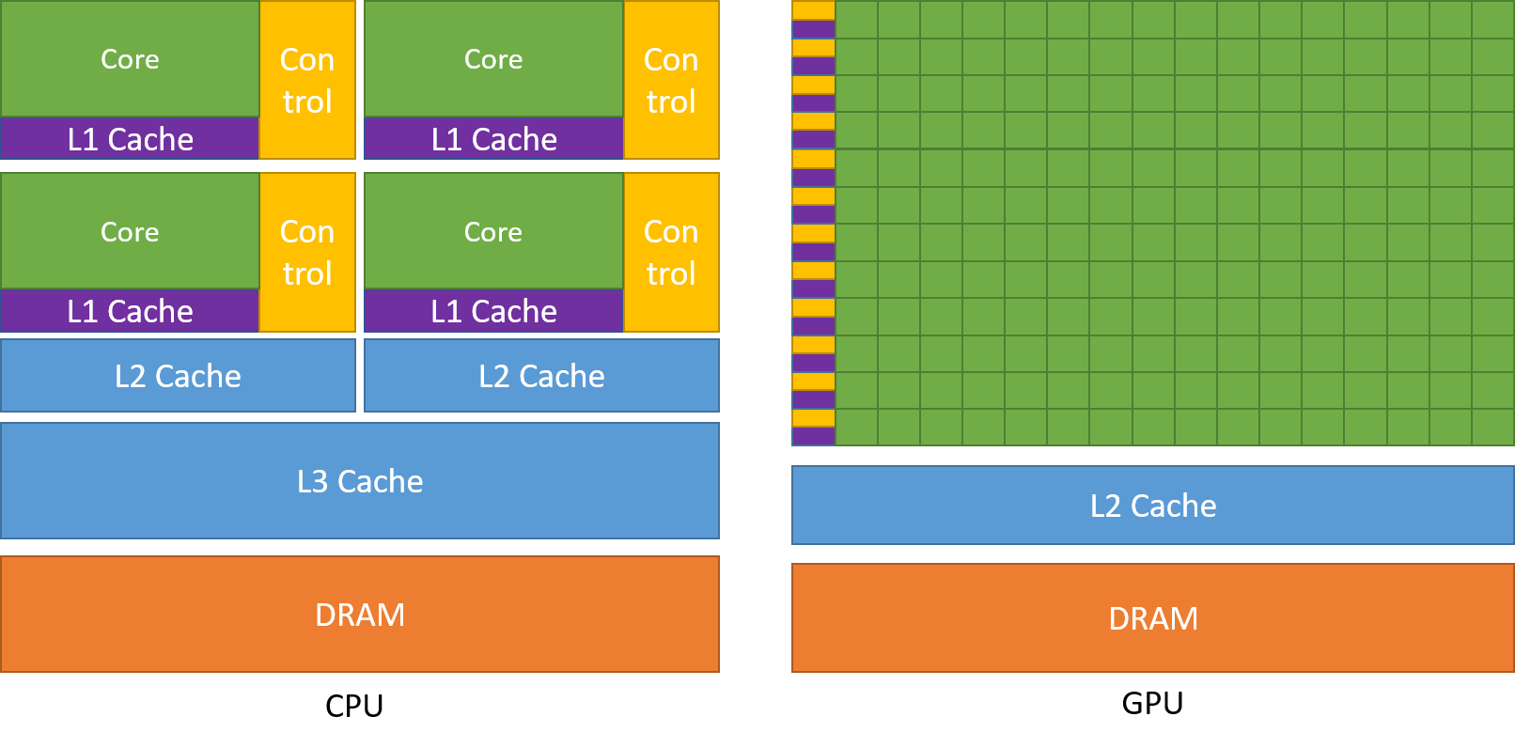
A stop 🚏 in GPU Land
Let’s have a look at the design of GPUs
Architecture (CPU vs GPU)

Slide 21
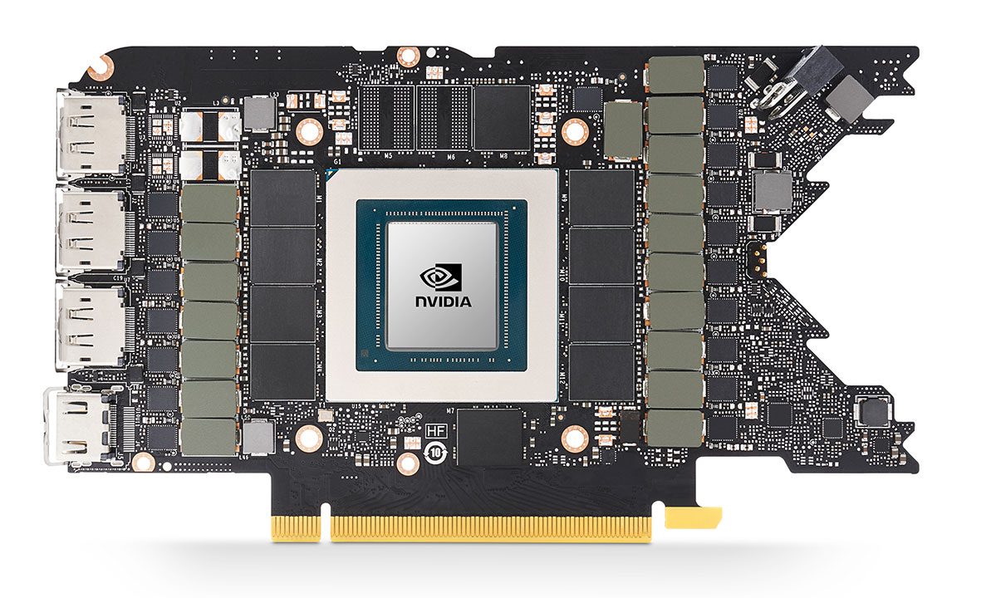
RTX3080 (Ampere)
https://videocardz.com/newz/nvidia-geforce-rtx-3090-and-rtx-3080-reference-board-designs-pictured

Slide 22
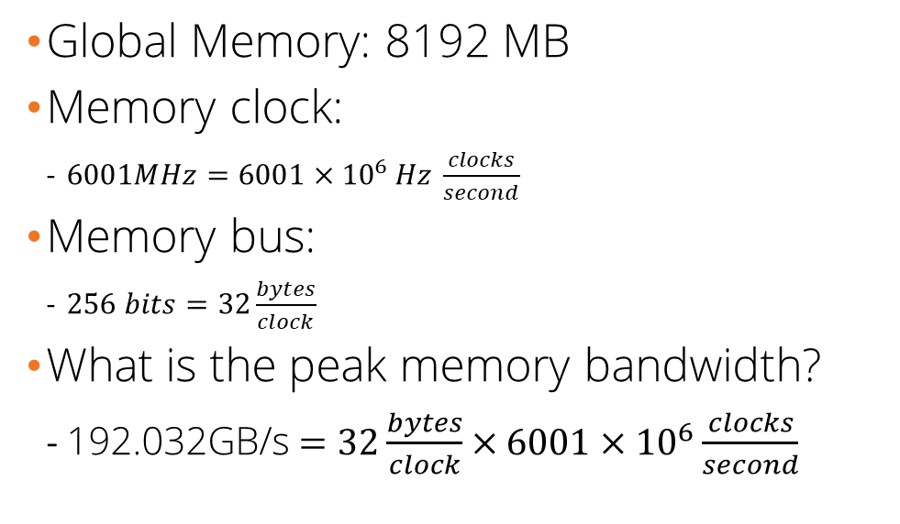
Memory
Global Memory: 8192 MB
Memory clock:
$6001MHz=6001×{10}^{6 }Hz \frac{clocks}{second}$
Memory bus:
$256 bits=32\frac{bytes}{clock}$
What is the peak memory bandwidth?
192.032GB/s $=32\frac{bytes}{clock}×6001×{10}^{6}\frac{clocks}{second}$
GDDR6X
https://wccftech.com/nvidia-geforce-rtx-2080-turing-tu104-gpu-pcb-exposed/
Notes:
8 bits = 1 byte. 1,024 bytes = 1 kilobyte. 1,024 kilobytes = 1 megabyte. 1,024 megabytes = 1 gigabyte for storage, but base 10 for transfer

Slide 23
Chip
GA104

Slide 24
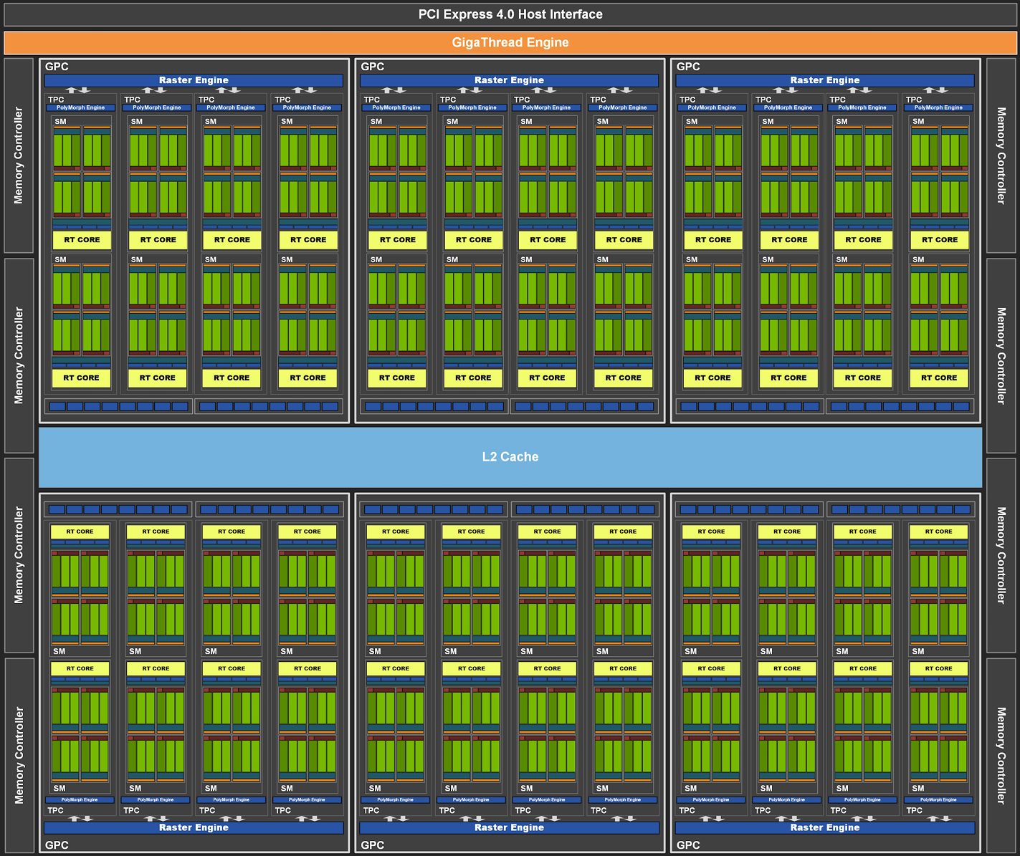
GA104
Compute capability: 8.6
Number of Streaming Multiprocessors (SM): 48

Slide 25
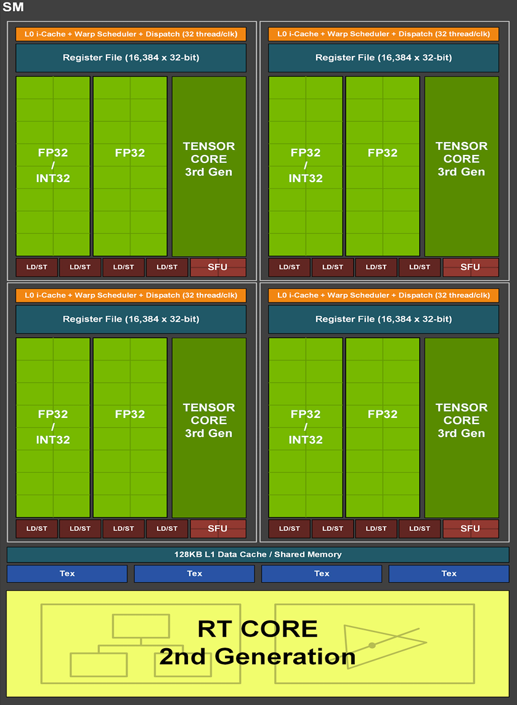
Streaming Multiprocessor
48 SM
Warp size: 32
Threads: 1536
GPU max clock rate: 1320 MHz
CUDA cores per SM:
FP32 x 128, INT32 x 64, FP64 x 2
16.22 TeraFLOPS

